Slide 1
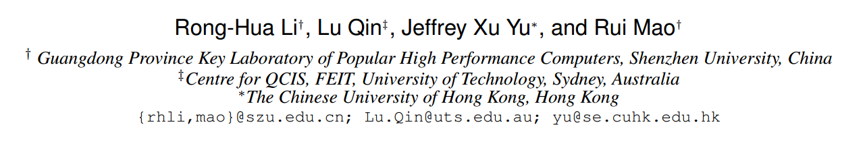
Efficient and Progressive Group Steiner Tree Search
SIGMOD-2016
TianzhuWei
2016/10/19

Slide 2
Contents
Problem definition
Exist Solution
Our Solution
Experiments
Conclusion

Slide 3
The GST Problem
Group Steiner Tree
1
1
Given a weighted and labelled ( S ) graph G ;
A subset of labels P ( P ⊆ S ) ;
4
4
4
4
4
4
1
1
1
1
Find the minimum weight connected tree from G that includes all the labels in P
v1
v2
v3
v4
Notes:
边加权 ST 问题
每一个结点都有含有多个标签
给定一个查询标签集合P

Slide 4
Exist Solution
The parameterized DP algorithm
v
T(v,X)
The optimal weight of the state (v , X ) could be obtained by :
u
T(u,X)
a ) Edge growing operation
V
T(v,X)
X
b ) Tree merging operation
X
X = X₁ ∪ X₂
(X₁ ∩ X₂=NULL)
T(v,X₁)
v
v
T(v,X₂)
X₁
X₂
Notes:
state (v , X ) 表示以 v 为根，含有标签集合 X 的树

Slide 5
v7
Exist Solution
The parameterized DP algorithm
4
v5
v7
v5
v5
v6
v6
v7
v7
v8
v8
v5
Priority Queue
1
1
1
1
4
4
4
4
1
v1
v2
v3
1
4
1
1
v9
v4
v1
v1
v1
v2
v3
v4
v1
v2
v3
v4
v1
a) maintain the states (e.g., (v , X ))
b) the weight of a state is the priority of that state
1
v7
v8
1
Initially , if v contains keywords p then v enqueueT(v,p) into Q
a ) Edge growing operation
v5
v5
1
1
4
Single node tree are with a zero cost
T ( v , p ) = 0
4
4
4
4
4
4
4
v
b ) Tree merging operation
v
v5
v1
v2
v6
1
1
1
1
1
1
1
1
1
4
1
v1
v2
v3
v4
Limitations:
a) the time complexity
b) the algorithm only generates a solution when it terminates
v1
v2
v3
v4
Notes:
优先队列
按照入队子树的权重和进行排列，权重越小，优先值越高
V1 v2 v3 v4 拥有我们给的查询的标签
局限：
时间复杂度 当给定的查询关键字个数大于8个时（当处理比较大的图时）就已经不能得出结果，同时也非常占用空间
我感觉不能算是缺点 只有当程序结束时才能得到结果。

Slide 6

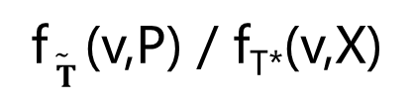


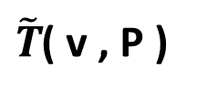

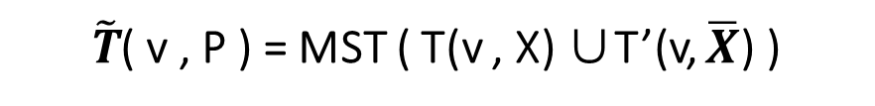

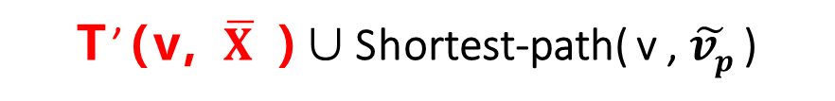


Priority Queue
a set D to maintain all the states
that have been computed
The Basic algorithm
$\tilde{T}$( v , P )
v1
v2
v3
v4
Preprocessing
a ) Edge growing operation
1
1
create a virtual node $\tilde{vp}$ , for a label p ∈ P ;
create an undirected edge( $\tilde{vp}$ , v ) with zero weight for each v ∈ V that includes a label p ;
compute the single-source shortest path from $\tilde{vp}$ to all the other nodes in the graph G.
b ) Tree merging operation
$$\overline{X}= P\backslash X$$
T(v,X )
T’(v, $\overline{X}$ )
4
4
4
4
4
4
approximation ratio
1
1
1
1
$\tilde{T}$( v , P ) = MST ( T(v , X) ∪T’(v, $\overline{X}$) )
f$\tilde{ T}$ (v,P) / f_{T*}(v,X)
T’(v, $\overline{X}$ )∪Shortest-path( v , $\tilde{vp}$ )
v1
v2
v3
v4
$\tilde{vp}$1
$\tilde{vp}$2
$\tilde{vp}$3
$\tilde{vp}$4
Notes:
使用 Dijkstra 方法求解 $\tilde{vp}$ 到其它 V 结点的最短路径
T’ ( v , $\overline{X}$) 将v 到$\overline{X}$ 虚拟结点的最短路径进行合并构成一棵树
然后将 T(v, X)与 T’ ( v , $\overline{X}$) 进行合并形成的最小生成树（MST）
这样获得一个可行解
当我们再进行 边添加 子树合并时就要进行 增长之后的 权重和是否小于 Best的权重，如果大于就舍弃不再进行操作
注意我们会用一个 D 来保存已经求得的状态的最优
注意合并时 X 与X- 不能有交集

Slide 7
The PrunedDP algorithm
u
Optimal-Tree Decomposition Theorem
Recall that in the Basic algorithm
To obtain the optimal solution f∗(P) for a query P , the algorithm must compute the optimal weights of all the intermediate states that are smaller than sub-optimal solutions .
For T*(P ) always exists a node u ∈ T* (P) :
the T*(P ) rooted at u has k (k ≥ 1) subtrees T1 , T2 , …Tk;
each subtree Ti has a weight smaller than f∗ (P) / 2 .
v1
v2
……
vk
T1
T2
T3
compute all the optimal subtrees that have weights smaller than f*(P )/2
merge the results obtained from the first stage to get the optimal tree.
Notes:
Assume that each edge in the graph G has a positive weight.
定理

Slide 8
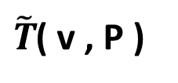
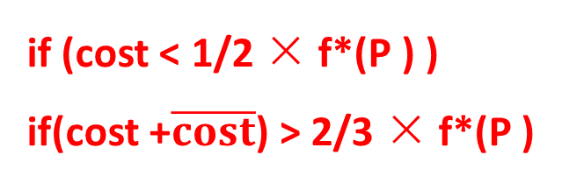
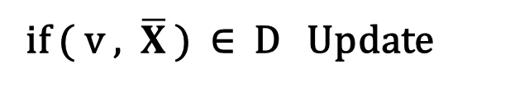
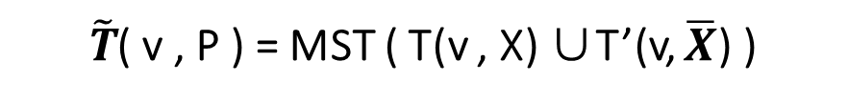
The PrunedDP algorithm
Priority Queue
{ a set D }
$\tilde{T}$( v , P )
Conditional Merging Theorem
v1
v2
v3
v4
merge two subtrees T (v, X ) and T (v, X’ ) for X’⊂ P \X only when
the total weight of these two subtrees is no larger than 2/3 × f*(P )
Optimal-Tree Decomposition Theorem
if (cost < 1/2 × f*(P ) )
if(cost +$\overline{cost}$) > 2/3 × f*(P )
if ( v , $\overline{X}$ ) ∈ D Update
$\tilde{T}$( v , P ) = MST ( T(v , X) ∪T’(v, $\overline{X}$) )
Notes:
这个定理我估计作者是偶然猜测出来的，证明很马虎。。。。。cry...s
大于 2/3 f*（P）的状态不需要树合并操作来进行
通过两个定理来减少了中间状态的求解次数 ，注意是 减少了求解次数

Slide 9





The PrunedDP++ algorithm
A* -search strategy
Heuristics
$$f\left(n\right)=g\left(n\right)+h(n)$$
Breadth-First-Search
A*-search strategy
Differences between PrunedDP++ and PrunedDP ：
The priority in the Priority Queue
in the update procedure, PrunedDP++ needs to invoke the lb procedure
Priority Queue
$$f∗\left(v,X\right)$$
$$+$$
$$lb$$
approximation ratio
f$\tilde{ T}$ (v,P) / $lb$
Notes:
首先对比一下搜索效果
A* 是一种用于寻找最短路径的搜寻策略
PrunedDP++方法与 PrunedDP方法在计算的流程上是极为相似的，区别在于在优先队列中的优先值计算时发生了一点点改变
由之前的比较每个状态自身的权重值大小改为了自身权重值加了一个启发式估计的一个值

Slide 10
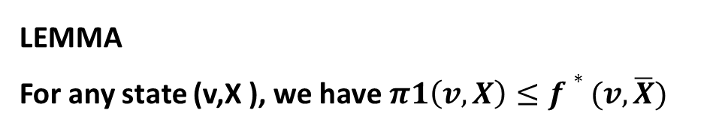

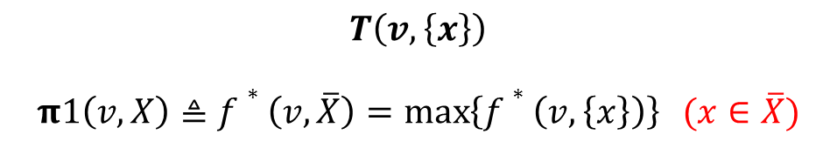




The Progressive A* Algorithm
One-label lower bound
$$T(v,\overline{X})$$
$$f\left(n\right)=g\left(n\right)+h(n)$$
consider the optimal connected tree rooted at v that covers only one label in $\overline{X}$ .
$$f\left(n\right)=g\left( v,X \right)+h(v,\overline{X})$$
$\overline{X}$ = P\X
$$T\left(v,\left\{x\right\}\right)$$
$$π1\left(v,X\right)≜f∗\left(v,\overline{X}\right)=\max\left\{f∗\left(v,\left\{x\right\}\right)\right\} (x∈\overline{X})$$
LEMMA
For any state (v,X ), we have$π1\left(v,X\right)≤f∗(v,\overline{X})$
Notes:
也就是说寻找（v,X-）的我们能肯定的最大的值

Slide 11
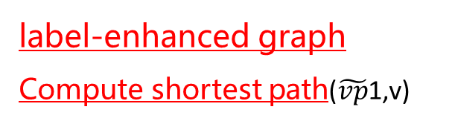


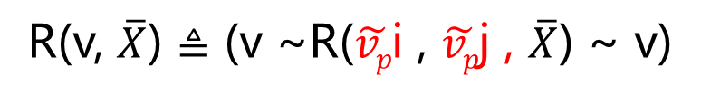
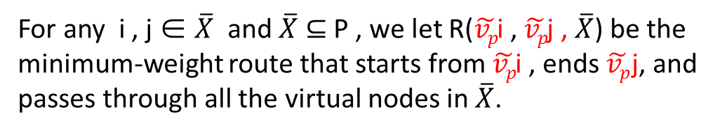

label-enhanced graph
Compute shortest path($\tilde{vp}$1,v)
The Progressive A* Algorithm
1
v9
1
v7
v8
Tour-based lower bound
4
4
4
$\tilde{vp}$i
4
4
4
For any i , j ∈ $\overline{X}$ and $\overline{X}$ ⊆ P , we let R($\tilde{vp}$i , $\tilde{vp}$j , $\overline{X}$) be the minimum-weight route that starts from $\tilde{vp}$i , ends $\tilde{vp}$j, and passes through all the virtual nodes in $\overline{X}$.
v5
v6
v
$$\overline{X}$$
1
1
1
1
v1
v2
$\tilde{vp}$j
v3
v4
R(v, $\overline{X}$) $≜$ (v ~R($\tilde{vp}$i , $\tilde{vp}$j , $\overline{X}$) ~ v)
Euler tour
$\tilde{vp}$1
$\tilde{vp}$2
$\tilde{vp}$3
$\tilde{vp}$4
$$π1\left(v,X\right)≜\min\left\{dist\left(v,\tilde{vp}i\right)+w\text{(}\tilde{vp}\text{i} \text{, }\tilde{vp}\text{j} \text{,} \overline{X}\text{)}+dist\left(v,\tilde{vp}j\right)\right\}/2 (i,j∈\overline{X})$$

Slide 12
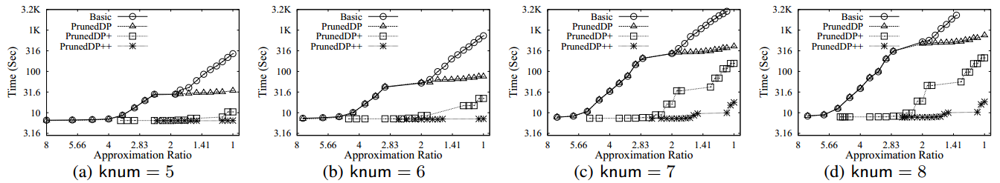
Experiments
Query Processing Time vs. Approximation Ratio: Vary Number of Labels (knum) on DBLP
Notes:
查询的关键字个数变化时

Slide 13
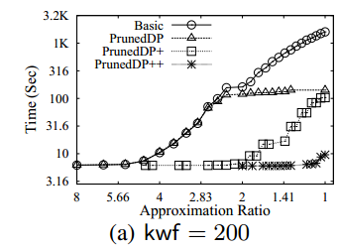
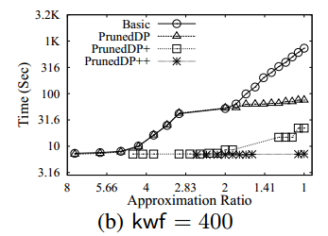
Experiments
Query Processing Time vs. Approximation Ratio: Vary Label Frequency (kwf ) on DBLP

Slide 14
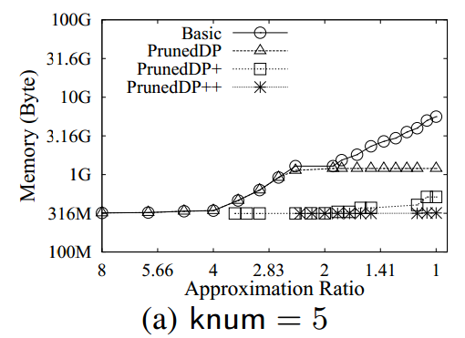
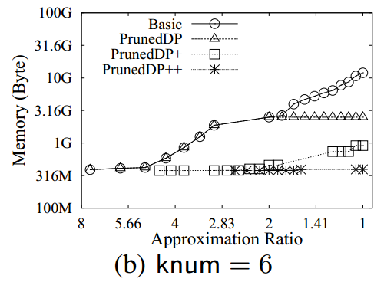
Experiments
Memory Overhead vs. Approximation Ratio: Vary Number of Labels (knum) on DBLP

Slide 15
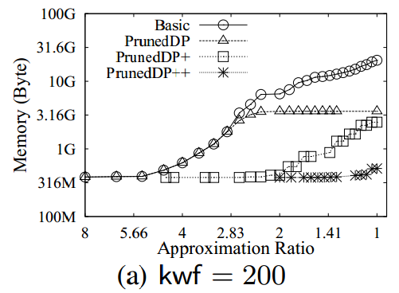
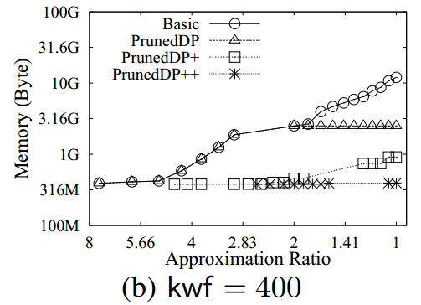
Experiments
Memory Overhead vs. Approximation Ratio: Vary Label Frequency (kwf ) on DBLP

Slide 16
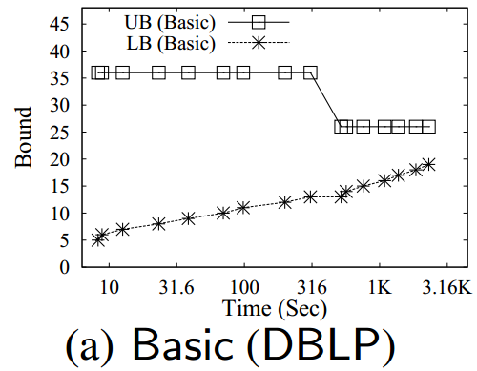
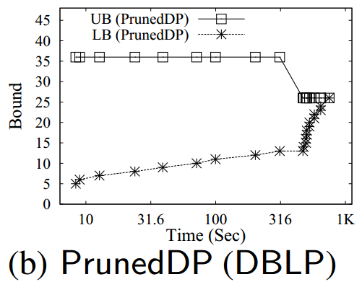
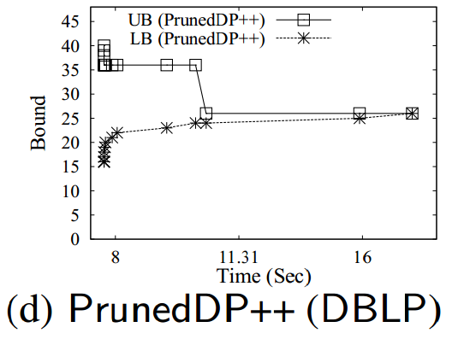
Experiments
LB denoted the lower bounds
UB the weights of the feasible solutions
Progressive Performance Testing (knum = 8; kwf = 400)

Slide 17
Conclusion
The parameterized DP algorithm
The Basic algorithm
The PrunedDP algorithm
The PrunedDP++ algorithm

Slide 18
Thanks

